Slide 1


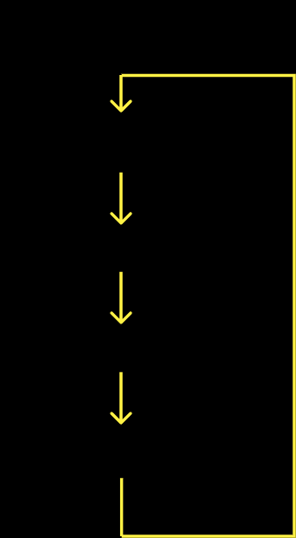

ПРИМЕР ПОСТРОЕНИЯ МОДЕЛИ УПРАВЛЕНИЯ
BEFORE
AFTER
OLD TEAM
FOUNDER
+
CO-FOUNDERS
INVESTOR REPRESENTATIVES
+
EMPLOYEE
NEW FUNCTIONS
OUTSOURSERS
+
NEW PARTNERS

Slide 2

BODY
CONSIST
FUNCTION
SCHEDULE
NECESSITY
- Approval of the
governing bodies
- Amendment of the SHA
- Adoption of reports
and balance sheets
- Shareholders Meeting
- According to shares
- At least once a year
May be called out of turn
- High
- 1-2 project representatives (usually Founder / CEO & CFO)
- 1-2 investor representatives
- 1-2 independent members (experts
- Approval of the business model and strategy
- Key appointments
- Consideration of reports
- Meets regularly
every 3-6 months
- May be called out of turn
- Board of Directors
- High
- Advisory Board
(sometimes Scientific Council)
- Consulting
- Agreeing strategic decisions.
- Developing a network of partners
- Meet as necessary
- The members may actindependently of each other
- 5-10 of an industry representatives with a good reputation
- Average
- Auditing Committee
- At least 2 elected members
Monitoring and control
Report preparation
- For the specific needs
- Low
- Supervisory Council
- 10-20 public persons
- PR
- Lobbying
- Meets regularly every 6-12 months
- Low

